Slide 1



Slide 2


Goals and Study Area
Overall goal - identify appropriate and commercially viable tourism development opportunities on current municipal land within the Duiker Street Precinct, and provide a Master Plan for the appropriate and optimised development of the precinct.

Slide 3
Key Outputs
An inception report (Completed).
Report and maps identifying environmental opportunities and constraints to development interventions (Completed).
Report and maps detailing relevant planning information (current zonings, land ownership, applicable by-laws, relevant legislation). (Completed).
Stakeholder engagement plan - analysis of key stakeholders and outcome of focused stakeholder engagement. (Completed).
Draft Concept Precinct Development Plan that provides a layout of the preferred development options, and a report on each proposed development intervention. (Draft completed and to be discussed today).
Final Concept Precinct Development Plan and report (To be completed in Phase III).
High-level economic analysis of the development options, and preliminary thoughts on funding opportunities and funding models. (To be completed in Phase III).

Slide 4
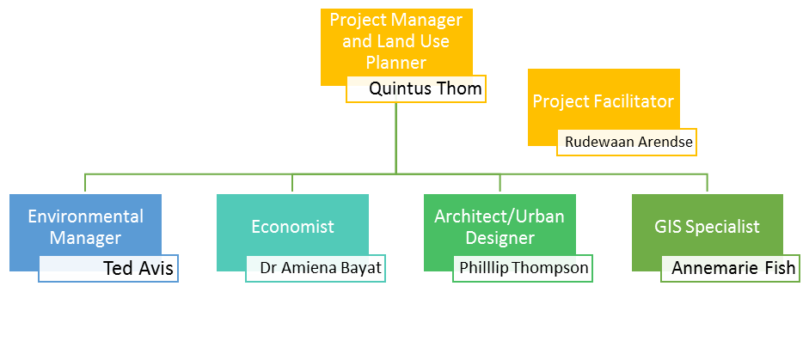
Team Structure

Slide 5
Phase II: Data collection, Public Participation and Reporting
Reviewed environmental documents and reports, and prepared an “Environmental Situation Assessment report”
Reviewed planning documents and reports and prepared a “Strategic Planning Overview Opportunities and Constraints Report”.
Held meetings with the Mayor, Ward Councillor, Ward Committee and relevant municipal officials to identify:
  potential stakeholders,
  interests and objections,
  expectations and aspirations,
  opportunities and constraints;
  historic, current and proposed plans, and
  surrounding plans and developments that may affect the site.

Slide 6
Phase II: Reporting
Prepared the Draft Duiker Street to Struisbaai Harbour Precinct Options analysis.
The primary assets which formed the basis of the options analysis were:
The beach and the marine interface that links to the Harbour.
Land fronting onto the beach, including the Caravan Park and day facilities.
The Harbour and the development potential within the Harbour.
Land adjacent to the Harbour which is owned by the Municipality.
The central business zone and adjacent development opportunities.
The interface with the main road and associated development opportunities.
Prepared the Initial Struisbaai Precinct Development Plan which included:
A set of land use planning guidelines that relate to the recommended land uses, providing detail in respect of development parameters associated with building lines, height, coverage, floor factors, etc.
Recommendations for developable areas within the precinct and concept layouts on the appropriate types of developments in response to the environmental opportunities and constraints.
Recommendations for appropriate commercial and tourism activities within the coastal zone and the urban area.
Preliminary recommendations relating to traffic flows and pertaining to parking areas to inform a future Traffic Impact Assessment.
Recommended architectural responses within the coastal zone, and urban form of the streets within the urban zone area not proximate to the coastline.

Slide 7
Phase II: Public Participation
Present the Struisbaai Precinct Development Plan to stakeholders
This is the objective of todays meeting.
The draft plan was completed in late March but presentation has been delayed due to Covid and lockdown restrictions.

Slide 8

www.cesnet.co.za
Grahamstown | Cape Town | East London | Johannesburg | Port Elizabeth | Maputo (Mozambique) | Romsey (UK)
Tel: +27 (0)46 622 2364 | Tel: +27 (0)21 045 0900 | Tel: +27 (0)43 726 7809 | Tel: +27 (0)11 607 8278 | Tel: +27 (0)41 393 0700 | Tel: +258 (0)84 359 1856 | Tel.: +44 (0)1794 501 104

